Slide 1
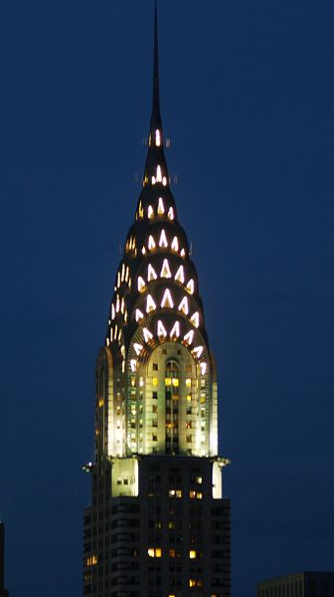
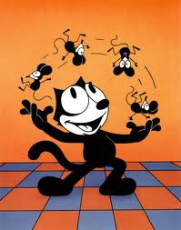
The 1920s

Slide 2
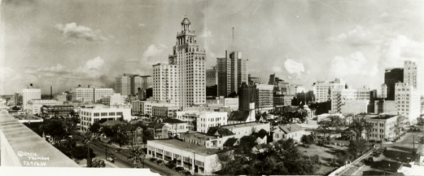
Downtown Houston 1927

Slide 3
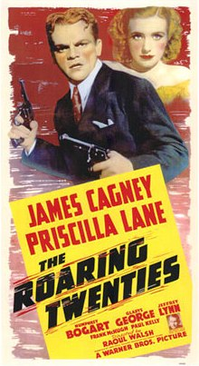
Life in the Roaring Twenties

Slide 4
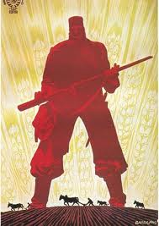
I. Adjusting to Peace
The Red Scare was –
fear of communism

Slide 5
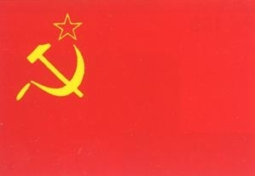
The Causes of the Red Scare…
1.Successful Bolshevik Revolution in Russia in 1917. Could we be next?
As a matter of fact there was a socialist political party in the U.S., as well as people who called themselves communists or anarchists.
2. Labor unrest and race riots were seen as a communist plot to overthrow U.S.
3. Mysterious bombings were seen as proof that the “revolution” had started.

Slide 6
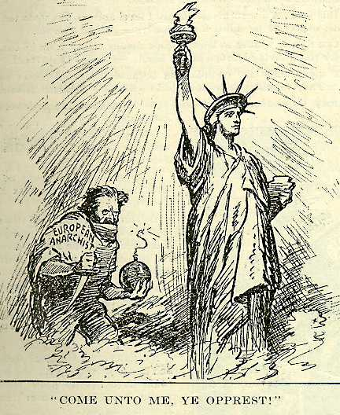

Slide 7
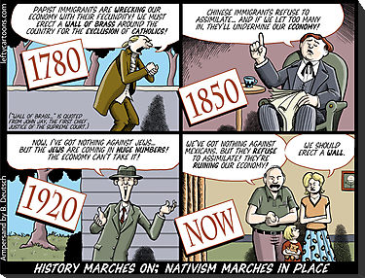
Growing Anti-Immigrant Sentiment
Americans tended to associate immigrants with communism.
Nativism (favoring native inhabitants of a region) and xenophobia (fear of foreigners) resurfaced.

Slide 8
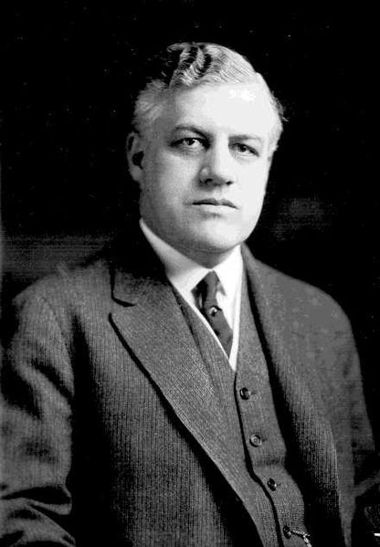
A man named A. Mitchell Palmer raided meetings, arresting and deporting aliens – known as the Palmer Raids
Anti-Immigration legislation passed such as the Emergency Quota Act and National Origins Act to limit immigration.

Slide 9
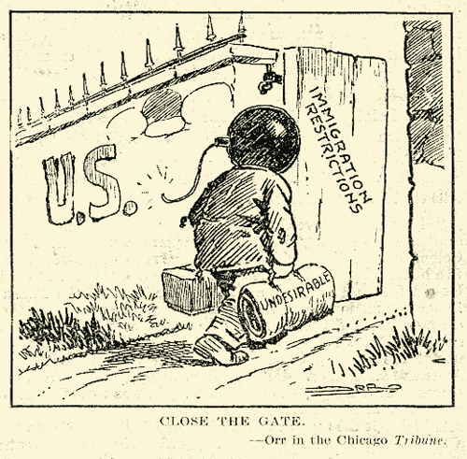

Slide 10
Eugenics Movement
Eugenics - a pseudo-scientific belief that the human race could be improved by breeding.
Eugenicists wanted to reduce immigration to the US and believed in forced sterilization, segregation laws, and marriage restrictions
The belief in eugenics spread from the US to Germany

Slide 11
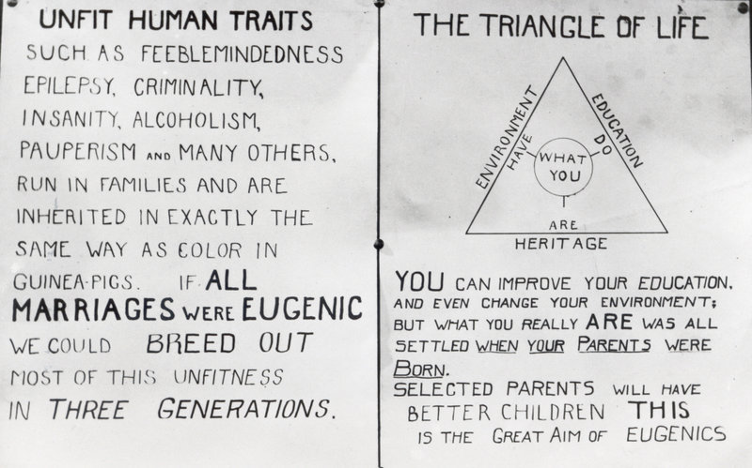

Slide 12
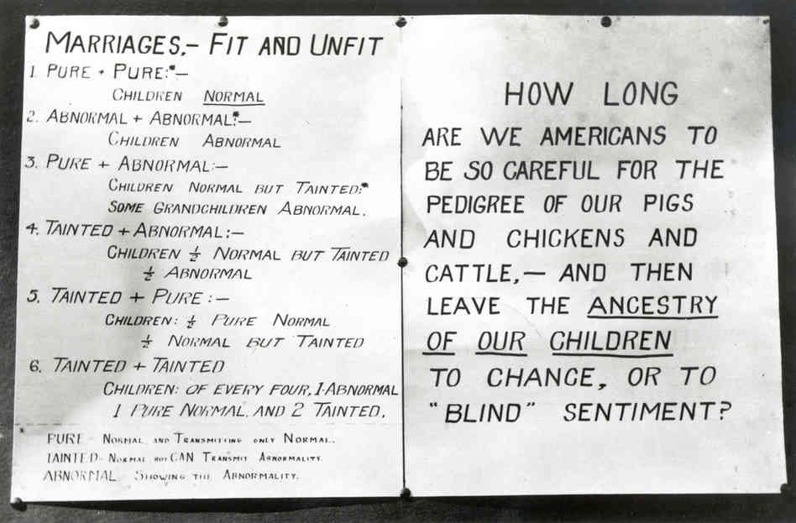

Slide 13
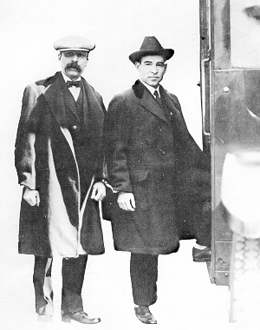
The Sacco and Vanzetti Case
Two Italian anarchists put on trial for robbery and murder in 1921.
Found guilty despite lack of solid evidence.
Verdict called the nation’s attention to the unfair treatment of immigrants.

Slide 14
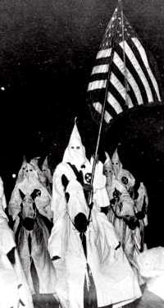
Rebirth of the Ku Klux Klan
Since the days of Reconstruction the KKK had become far less popular and was very seldom in the news.
During the 1920s it was resurrected by a new national organization, selling memberships in every part of the U.S.

Slide 15
Klansmen were pro-“American”, anti-black, anti-Hispanic, anti-Catholic, anti-Jew, anti-immigrant, and anti-communist.
Klan membership grew to over 4 million.
The national organization collapsed after a scandal in the late 1920s.
The Klan’s temporary popularity illustrated the prejudice and intolerance of many people who feared the changes going on in America.

Slide 16
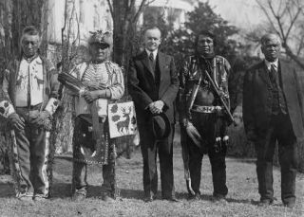
Indian Citizenship Act of 1924
Granted full citizenship to Native Americans
Partially in recognition of the thousands who served in World War I
Notes:
The text of the 1924 Indian Citizenship Act (43 U.S. Stats. At Large, Ch. 233, p. 253 (1924)) reads as follows:
BE IT ENACTED by the Senate and house of Representatives of the United States of America in Congress assembled, That all non citizen Indians born within the territorial limits of the United States be, and they are hereby, declared to be citizens of the United States: Provided That the granting of such citizenship shall not in any manner impair or otherwise affect the right of any Indian to tribal or other property."
Approved, June 2, 1924. June 2, 1924.
The Act granted citizenship to about 125,000 of 300,000 indigenous people in the United States. Those indigenous people that were not included in citizenship numbers had already become citizens by other means; entering the armed forces, giving up tribal affiliations, and assimilating into mainstream American life were ways this was done (Peterson 121). Citizenship was granted in a piecemeal fashion before the Act, which was the first more inclusive method of granting Native American citizenship. The Act did not include citizens born before the effective date of the 1924 act, or outside of the United States as an indigenous person, however, and it was not until the Nationality Act of 1940 that all born on U.S. soil were citizens

Slide 17
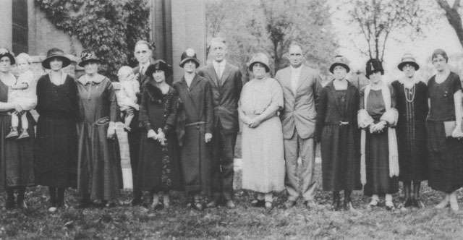
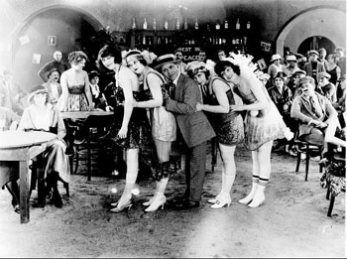
II. Cultural Changes

Slide 18
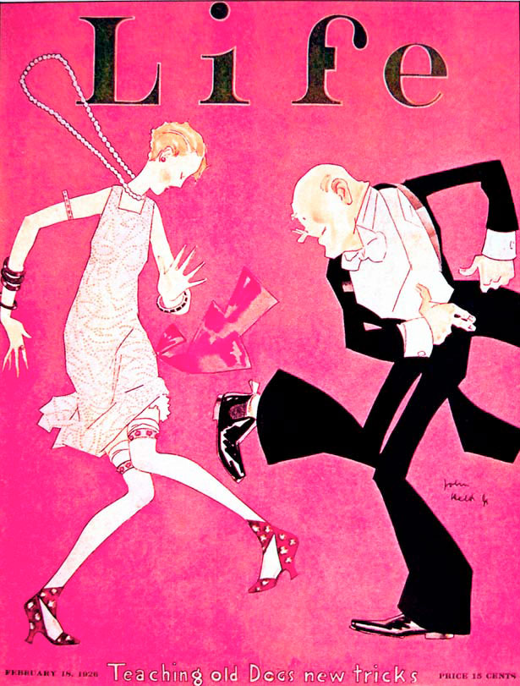
Clash between traditional and modern values
The “flapper” was a young woman who challenged traditional fashion and behaviors.
These young women often smoked and drank in public, cut their hair short, wore make-up and shorter hemlines.
Conservatives feared what they saw as a decline in morals.

Slide 19
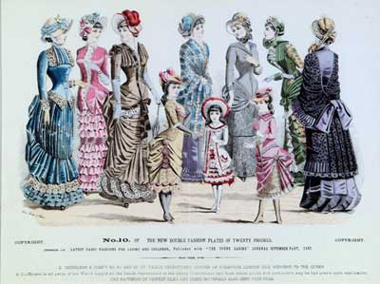
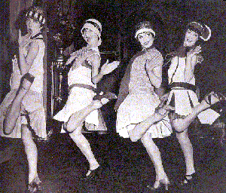
Victorian fashion (traditional)
Flapper fashion (modern)

Slide 20
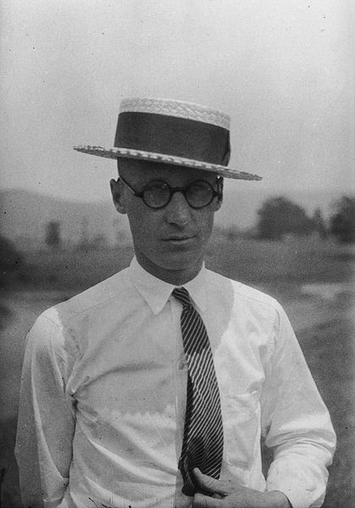
The Scopes “Monkey” Trial
One example of this clash between modern and conservative beliefs was the much-publicized Scopes Trial.
John Scopes was a science teacher who was charged with breaking a law which banned teaching the theory of evolution in Tennessee schools.
The Scopes Monkey Trial Clip
Notes:
The Scopes Trial, formally known as The State of Tennessee v. John Thomas Scopes and commonly referred to as the Scopes Monkey Trial, was a famous American legal case in 1925 in which a high school teacher, John Scopes, was accused of violating Tennessee's Butler Act, which made it unlawful to teach human evolution in any state-funded school. The trial was deliberately staged in order to attract publicity to the small town of Dayton, Tennessee, where it was held. Scopes was unsure whether he had ever actually taught evolution, but he purposely incriminated himself so that the case could have a defendant.
Scopes was found guilty and fined $100, but the verdict was overturned on a technicality. The trial served its purpose of drawing intense national publicity, as national reporters flocked to Dayton to cover the big-name lawyers who had agreed to represent each side. William Jennings Bryan, three-time presidential candidate, argued for the prosecution, while Clarence Darrow, the famed defense attorney, spoke for Scopes. The trial publicized the Fundamentalist–Modernist Controversy, which set Modernists, who said evolution was not inconsistent with religion,^{[2]} against Fundamentalists, who said the word of God as revealed in the Bible took priority over all human knowledge. The case was thus seen as both a theological contest and a trial on whether modern science regarding the creation-evolution controversy should be taught in schools

Slide 21
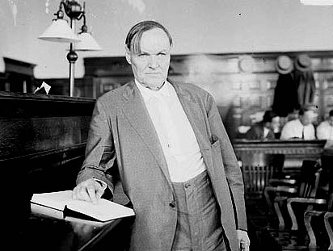
Scopes “Monkey” Trial
The trial sparked world-wide debate. It was really a fight over the role of science and religion in public schools and in American society.
Scopes was convicted and made to pay a small fine, but the debate continues . . .

Slide 22
The Era of Prohibition
The Temperance Movement had long worked to ban alcohol throughout the Gilded Age and the Progressive Era.
The 18th Amendment went into effect in 1920, prohibiting the manufacturing, transporting, and selling of alcohol.
However, the federal government was unable to enforce this effectively. Not enough funds were allocated and too few enforcement agents were hired.

Slide 23
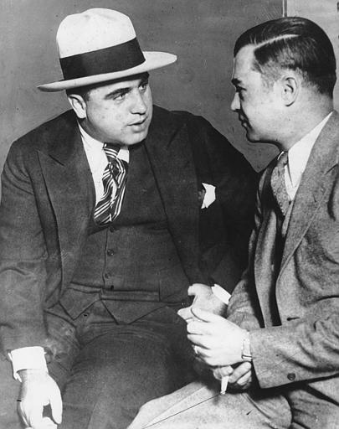
Gangsters such as Al Capone made millions of dollars selling illegal alcohol during prohibition.
Selling illegal alcohol was known as bootlegging.
"Assignment Discovery: Al Capone"

Slide 24
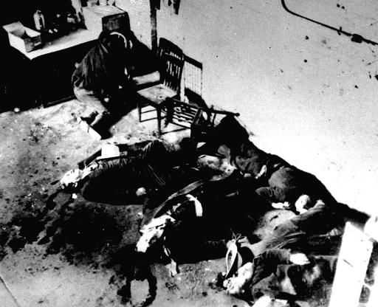
The bodies of six of the men slain Feb. 14,1929 on Chicago's north side in what became known as the "St. Valentine's Day massacre" sprawl on a floor and on a chair. This was an example of gang warfare over the business of bootlegging.

Slide 25
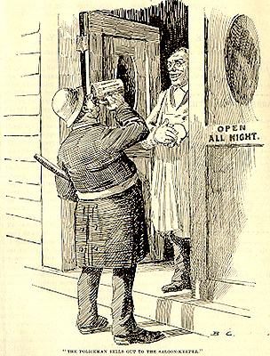
The Prohibition Experiment Fails
Organized crime made easy profits supplying alcohol to eager buyers.
Speakeasies were illegal bars that continued to operate throughout the Roaring Twenties.
Prohibition was repealed in 1933 with the passage of the 21st Amendment.
Prohibition video
Notes:
Prohibition encouraged speakeasies, and led to gangsters and organized crime. A speakeasy is an establishment that illegally sells alcoholic beverages.

Slide 26
The Harlem Renaissance
A literary and artistic movement celebrating African-American culture
Originated in Harlem, NY and spread to other major cities
Langston Hughes was the movement’s most famous poet.
The Harlem Renaissance — History.com Video
Notes:
The general awakening of African-American culture in the 20s
Begun by a rising middle class of Afr Am. Not just music – dance, visual arts as well. It sought to bring recognition to the Afr Am community. Renewed pride resulted, and this feeling spread from Harlem to other Afr Am communities.
Spurred by the Great Migration

Slide 27
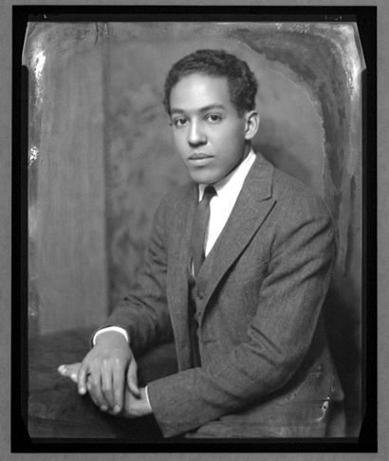
“I, Too” by Langston Hughes
I, Too
I am the darker brother.
They send me to eat in the kitchen
When company comes,
But I laugh,
And eat well,
And grow strong.
Tomorrow,
I'll be at the table
When company comes.
Nobody'll dare
Say to me,
"Eat in the kitchen,"
Then.
Besides,
They'll see how beautiful I am
And be ashamed--
I, too, am America.
Notes:
Born in Missouri, was drawn to Harlem to join other Afr Am artists and writers. His writing expressed the new mood of rugged determination to overcome racial prejudice. He drew on his personal experiences in writing about what it was like to be an Afr Am growing up in America.
His poems, novels, plays and newspaper columns made him one of the most popular writers of the Harlem Renaissance.

Slide 28
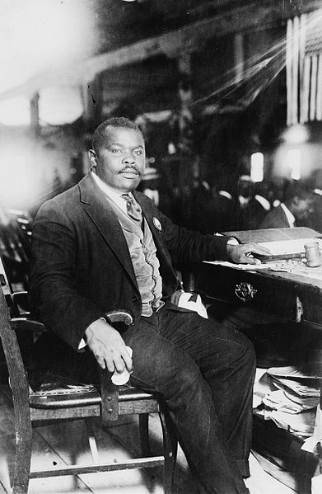
Marcus Garvey
African-American political activist who emphasized racial pride
His goal was the total liberation of African people around the world
Advocated the “Back-to-Africa Movement,” which supported a return to Africa, especially Liberia
Notes:
Jamaican born, controversial political activist. Known for fiery speech and fancy uniforms. Emphasized racial pride
Afr Am soldiers serving in France during World War I had witnessed a society in Eurpose that was more tolerant than in America. When many of them returned home, they found racism against Afri Am as deeply entrenched as before. Garvey helped to unite them.
He stressed racial unity through self-help. He encouraged Afr Am to set up their own shops and businesses.
Inspiration for the Nation of Islam

Slide 29
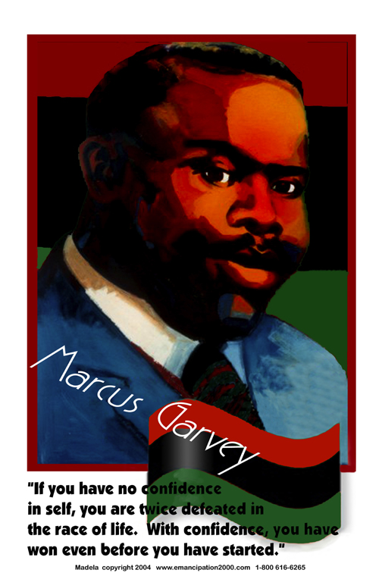
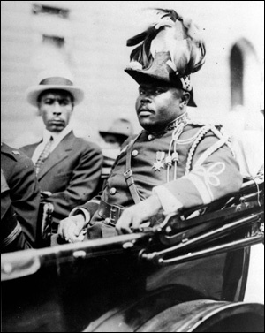
Notes:
Liberia is the only country in Africa founded by United States colonization while occupied by native Africans. Beginning in 1820, the region was colonized by black people from the United States, most of whom were freed slaves. These immigrants established a new country with the help of the American Colonization Society, a private organization whose leaders thought former slaves would have greater opportunity in Africa. African captives freed from slave ships by the British and Americans were sent there instead of being repatriated to their countries of origin. In 1847, this new country became the Republic of Liberia, establishing a government modeled on that of the United States and naming its capital city Monrovia after James Monroe, the fifth president of the United States and a prominent supporter of the colonization. The colonists and their descendants, known as Americo-Liberians, led the political, social, cultural and economic sectors of the country and ruled the nation for over 130 years as a dominant minority.
The country began to modernize in the 1940s following investment by the United States during World War II and economic liberalization under President William Tubman. Liberia was a founding member of the United Nations and the Organization of African Unity.

Slide 30
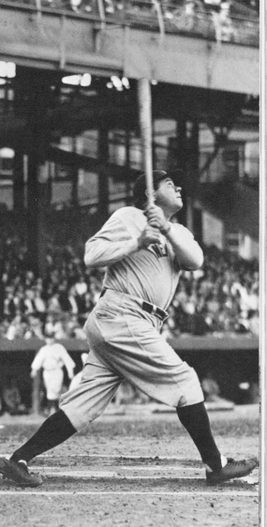
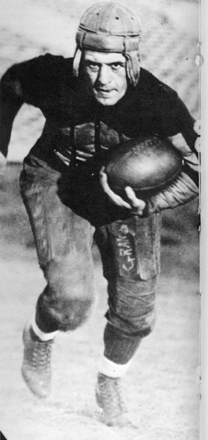
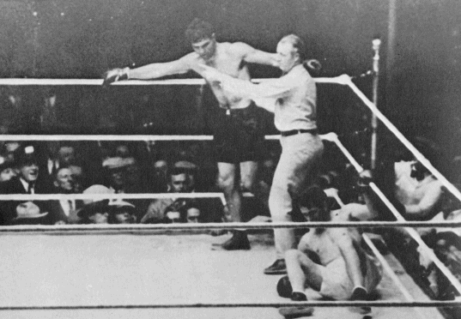
Spectator sports such as football, baseball, and boxing became popular, stadiums were built.
“Babe” Ruth
“Red” Grange
Jack Dempsey

Slide 31
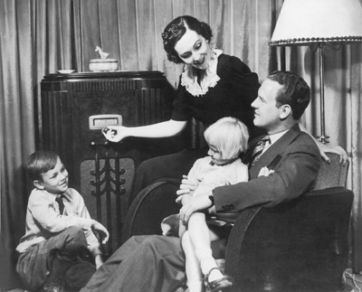
Radio, Music, Movies
Families gathered around their radios for night-time entertainment
Stations broadcasted music, sporting events, lectures, fictional stories, newscasts, weather reports, market updates, and political commentary
Notes:
Radio stimulated sports, music, and advertisement
In 1920 the first commercial radio stations with regularly scheduled broadcasts were heard

Slide 32
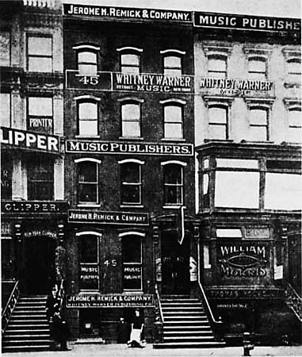
Tin Pan Alley
A section of New York City where American popular music was born
Sheet music published in Tin Pan Alley was sold to individuals and vaudeville shows
Notes:
After the Civil War, thousands of pianos were sold to individuals. As a result, the demand for sheet music exploded. Around 1910, NYC began to emerge as the capital of popular music publishing.
Tim Pan Alley was a section of NYC. This was the area where songwriting and musical ideas mixed together to form American popular music. Various styles, such as blues, jazz, and ragtime, were melded together.
Publishers were surprised to discover that sheet music for popular tunes was being bought up by ordinary people who just wanted to play these songs at home. During this same period, vaudeville became the most popular form of stage entertainment. Vaudeville shows had a great need for music and the publishing houses of Tin Pan Alley were glad to provide them since a great deal of money was made by selling the songs they published.
Songs such as In the Good Old Summertime, Give My Regards to Broadway, were all written for vaudeville. Tin Pan Alley saw the emergence of such famous song-writers as Irving Berlin, Cole Porter, Scott Joplin, and George Gershwin. These artists created some of the most memorable pieces in our nations’ songbook.

Slide 33
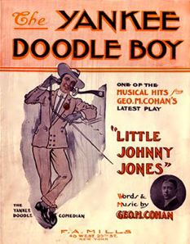
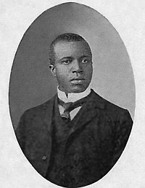
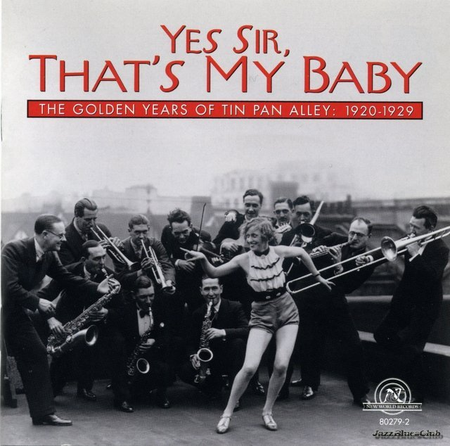
Songwriters such as Irving Berlin, Cole Porter, Scott Joplin, and George Gershwin emerged from Tin Pan Alley
Scott Joplin The Entertainer

Slide 34
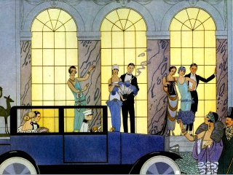
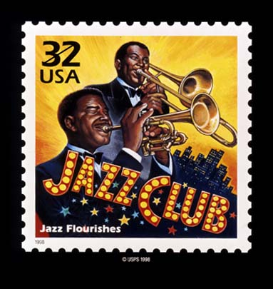
The Jazz Age
This new music called jazz got its start in New Orleans, the jazz capitol of the world.

Slide 35
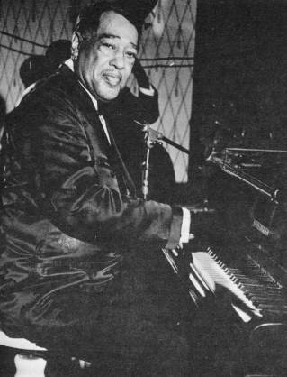
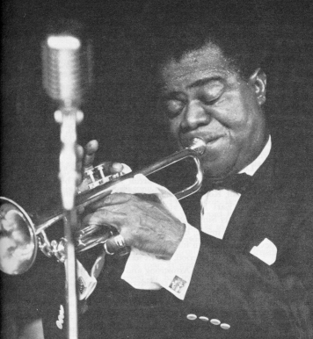
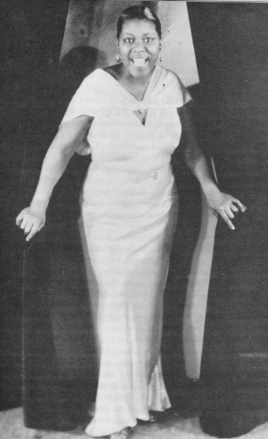
Louis Armstrong“Satchmo”
Duke
Ellington
American Jazz Age
Bessie Smith

Slide 36
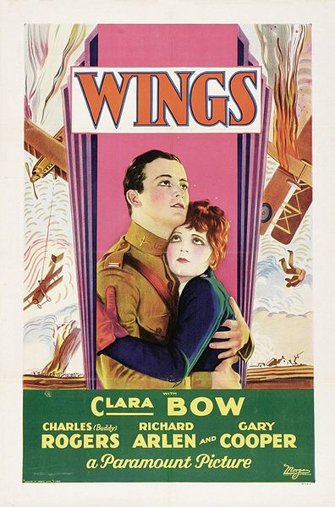
Movies
“Talkies” refer to films with spoken words. The first, The Jazz Singer appeared in 1927
The Academy Awards (aka the Oscars) were born in 1928

Slide 37
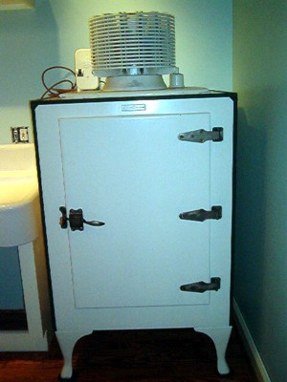
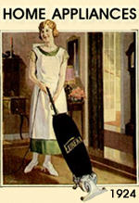
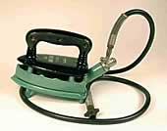
III. New Prosperity and
A Growing Economy
New sources of power: electricity and oil
New time-saving consumer goods - Electrical appliances like refrigerators, irons, vacuum cleaners, toasters, etc.

Slide 38
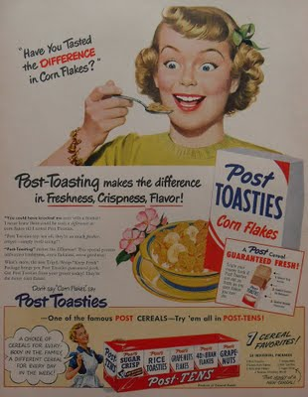
What caused
people to buy?
The rise of advertising and radio

Slide 39
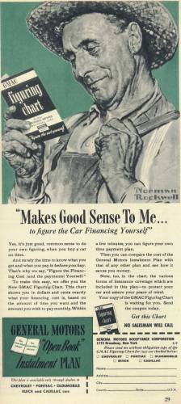
    Installment buying- downpayment and monthly payments (credit) – allowed people to buy even if they didn’t have the cash
    The economy grew along with consumer debt.

Slide 40
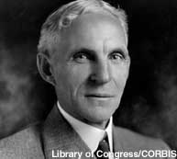
Henry Ford
His assembly line
process produced affordable cars for average Americans, transforming our lives.
He employed thousands of workers, preventing the formation of unions by giving his employees higher wages and benefits.

Slide 41
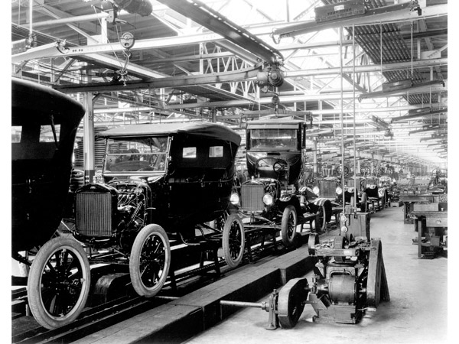

The cars move down the line as workers add parts to them in the assembly line.

Slide 42

How did the automobile impact America?

Slide 43

Mass Production Lowers Costs
Mass manufacturing of automobiles also led to the expansion of related industries -steel, rubber, glass, gasoline, road construction.
Most major industries adopted the assembly line process.

Slide 44

Charles Lindbergh
Lindbergh was the first man to fly non-stop across the Atlantic Ocean. His flight from New York to Paris thrilled the world.
He symbolized the true American hero: smart, independent, modest, courageous, and willing to explore new possibilities.

Slide 45

Lucky Lindy

Slide 46

His airplane was named the Spirit of St. Louis
Charles Lindbergh video

Slide 47

IV. Presidential Issues
Warren G. Harding’s “Return to Normalcy” campaign slogan supported a less ambitious foreign policy and a greater emphasis on prosperity at home after WWI.

Slide 48
From Harding’s 1921 Inaugural Address
“We must seek the readjustment with care and courage. We must strive for normalcy to reach stability. The forward course of the business cycle is unmistakable. People are turning from destruction to production. Industry has sensed the changed order and is turning to resume its normal, onward way. The call is for productive America to go on.”

Slide 49
Teapot Dome Scandal
One of the worst political scandals in US history
Harding appointed personal friends to his Cabinet, who turned out to be dishonest
One Cabinet member leased oil-rich government land at Teapot Dome, Wyoming, to two business friends in exchange for personal bribes

Slide 50


Slide 51
The successes and excesses of the 1920s set the stage for the Great Depression…what goes up, must come down!

Slide 52


Slide 53

Notes:
1920 The first commercial radio stations with regularly scheduled broadcasts were heard in 1920. WWJ (Detroit) (then known as "8MK") went on-air in August. KDKA (Pittsburgh) went on-air in November with the results of the 1920 Harding - Cox Presidential election.
[Some sources claim KQW in San Jose, California deserves the title of "First Commercial Station" because of its broadcasting in 1912. Donna Halper reminds us that Montreal's XWA was on the air in late 1919, and there were at least four stations regularly on the air in 1920]
Also See Elizabeth McLeod's Documenting Early Radio for information about 1920 - 1935 radio. 1921 The first sports broadcast was the Dempsey-Carpenter fight on July 2, 1921.
The Happiness Boys started a show, which continued (on various stations) until 1940.
First religious broadcast? KDKA aired the Sunday service of Pittsburgh's Calvary Episcopal Church on Jan 2nd. 1922 Donna Halper's research revealed that, in November of 1922, songs from the successful Broadway musical "Shuffle Along" were performed live by the original cast over station WNAC in Boston, one of the earliest examples of an African-American musical on radio (it featured Eubie Blake, Noble Sissle, and Lottie Gee, among others). 1924 National political conventions were heard on a nationwide network during the 1924 nomination season. (Calvin Coolidge won the Presidency. Here is an excerpt from one of Calvin Coolidge's speeches, preserved on a 78 RPM campaign handout.)
The A & P Gypsies appeared on WEAF (New York), and moved to NBC Red in 1926. For the next 10 years, this musical show (Harry Horlick and his orchestra) was heard nationally, on NBC Red or NBC Blue.
The National Barn Dance first heard on WLS (Chicago). The show was broadcast between 4/19/24 and 4/30/60 (and only 14 recorded shows remain) 1925 A year later, The Grand Ol' Opry appeared, and was heard on various stations until 1941, when it was picked up by NBC. Grand Ol' Opry was heard on NBC on Saturday nights (at about 9:30 or 10:30 PM) through 1956, when it became syndicated, and was heard on various other stations. 1926 The National Broadcasting Company (NBC) was established by RCA in 1926. "Red" and "Blue" Networks.
Among the shows broadcast that year were several orchestras, Ben Bernie, Will Rogers, Sam and Henry and Father Coughlin. The Betty Crocker Show started on NBC Red. 1927 The Columbia Broadcasting System (CBS) was founded.
NBC's Orange (West Coast) network founded.
Many musical shows on the air, including Chicago Civic Opera, National Symphony Orchestra, and the Goodrich Zippers (Banjo Ensamble),
Talk shows included: Auction Bridge, and Cook's Travelogue.
H. V. Kaltenborn, broadcasting news, was first heard on CBS [1955] 1928 Sam and Henry became Amos and Andy in 1928 when the show moved to NBC. The Amos and Andy show was on the radio through 1960 - making it the longest-running series in radio history. Here is an excerpt, discussing the 1928 election.
The Guy Lombardo Show [1967] started this year, as did the The Voice of Firestone and Uncle Don [1949]

